Slide 1
Distributed dependency injection in serverless scenarios
Project work on Distributed Systems M
Author:
fabio gentili

Slide 2
Introduction
The aim of this work is to propose an implementation of the Dependency Injection principle in Serverless systems
We will show how to implement it on the main public cloud platforms and we will test it to evaluate its performance

Slide 3
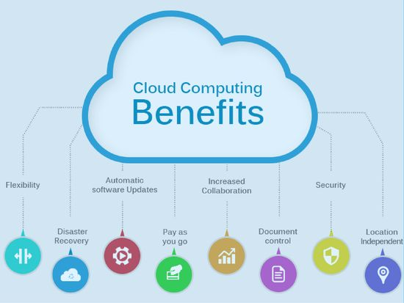
Cloud Computing
On-demand self-service
Broad network access
Resource pooling
Rapid elasticity
Measured service

Slide 4
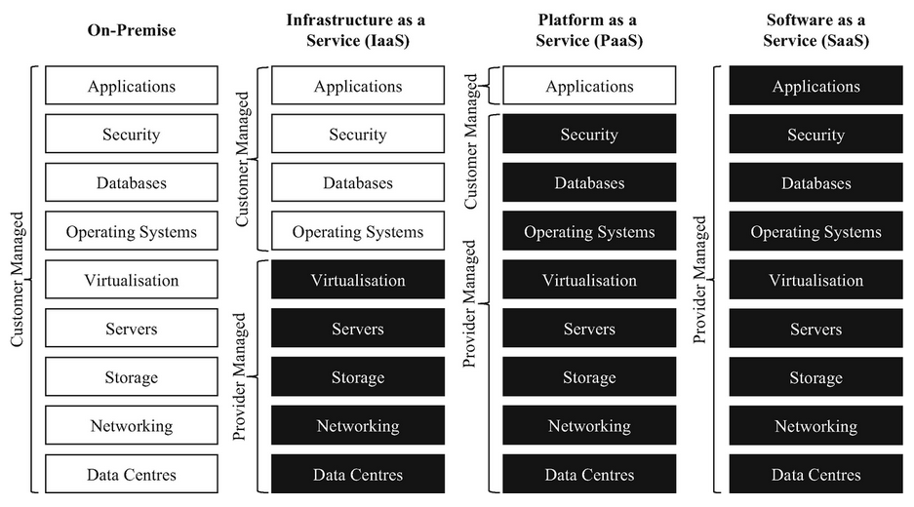
Service Models

Slide 5
Serverless Computing
Cloud-native development model that allows developers to build and run applications without having to manage servers.
The cloud provider is responsible for managing the scaling of the deployed apps, with the possibility of the so called “zero scaling”
Serverless encompasses two main models: BaaS e FaaS

Slide 6
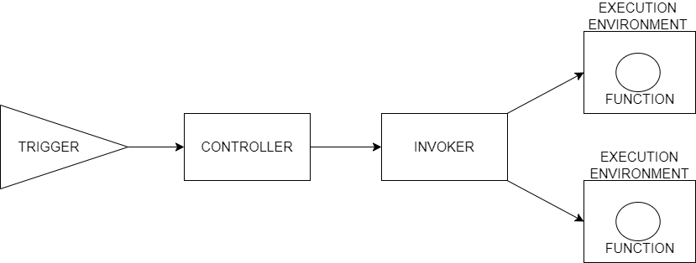
Function as a Service
Computational model based on events
“Functions” are triggered upon the arrival of predefined events
Functions run on ephemeral containers that are terminated at the end of the execution.
Trigger: creates a bridge between external events and those manageable by the FaaS infrastructure
Controller: associates functions with events received from the trigger.
Invoker: receives the events from the controller and instantiates the functions with their execution environments to produce the correspondent output

Slide 7
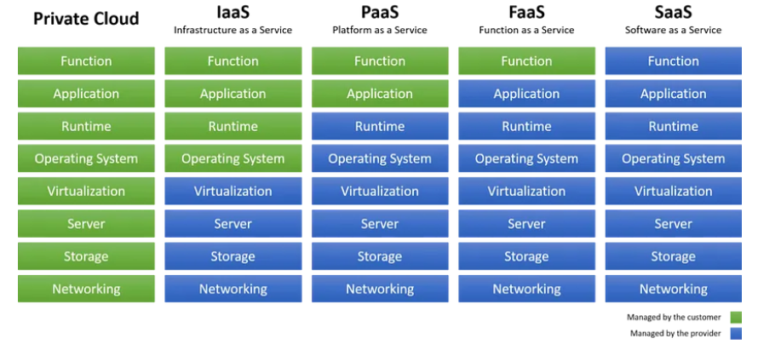
Service Model

Slide 8
Drawbacks and best practices
No in-server state
Cold starts
Testing
Idempotent code
Language choice and package size
Minimize dependencies complexity

Slide 9
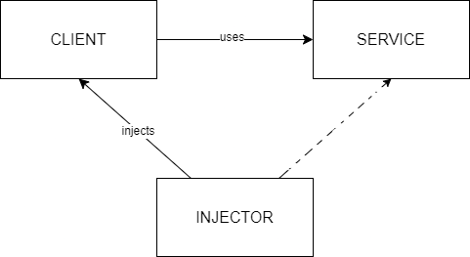
Dependency injection
OO design pattern
Allows the developing of loosely coupled code
Based on the idea of having dependencies injected by someone else instead of instantiating them
Client: the class that needs dependency.
Service: the class that is needed.
Injector: the class that creates the service and injects it into the client.

Slide 10
Benefits in Serverless scenarios
Loosely-coupled code
Enhanced testability
Separated concerns
Flexibility

Slide 11
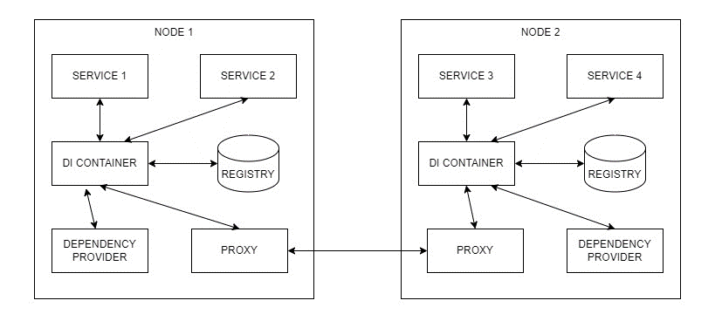
Distributed dependency injection
Distributed systems design pattern
Based on services, not objects
Scalability and efficiency constraints
Services: the basic components of distributed systems.
DI container: it is the component that exposes an API for the registration and retrieval of dependencies and that performs the injection at runtime.
Registry: it provides a centralized repository to store information about dependencies.
Proxy: it enables transparent inter-node communication to retrieve non-local dependencies.

Slide 12
AWS Lambda and Azure Functions
Two of the main public clouds’ offers for Function as a Service
Both give the possibility to create a free trial account
Both offer well integrated ecosystems
Both allow to use many different runtimes
AWS Lambda limits the maximum number of function instances running at the same time

Slide 13
First architecture implementation
We decided to implement the injector as a class inside our functions
We chose three different languages (Javascript, Java and Go)
We used DynamoDB and CosmosDB as registries
We created a simple function to be used as dependency provider

Slide 14
Injector SDK
Implemented with Singleton pattern to optimize the number of connections to the DBs
Exposes an API to perform CRUD operations on the DBs through the SDKs provided by the vendors

Slide 15
Performance testing
We disposed a stresser to invoke our functions through HTTP triggers
It simulates a constant workload followed by a peak of requests
We kept track of functions duration, access time to DBs and service binding duration using vendors’ monitoring systems

Slide 16
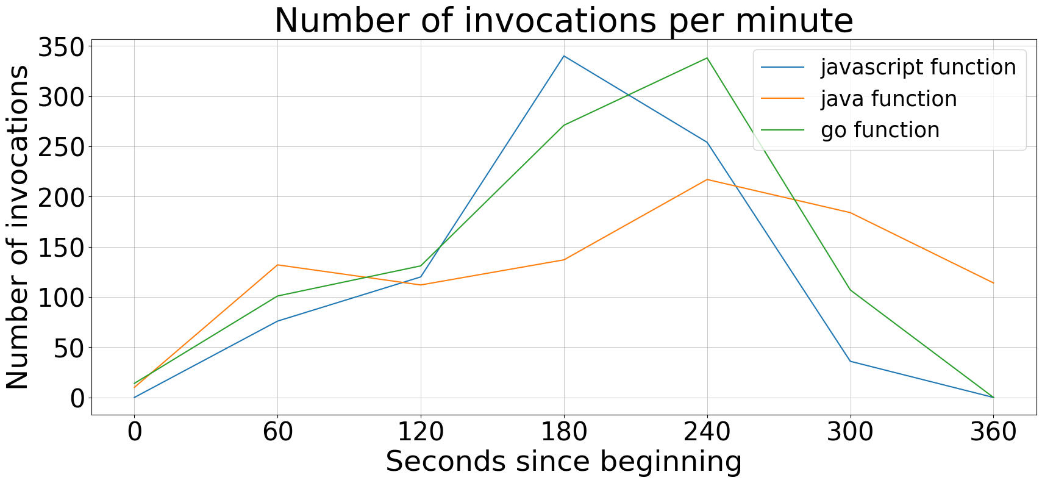
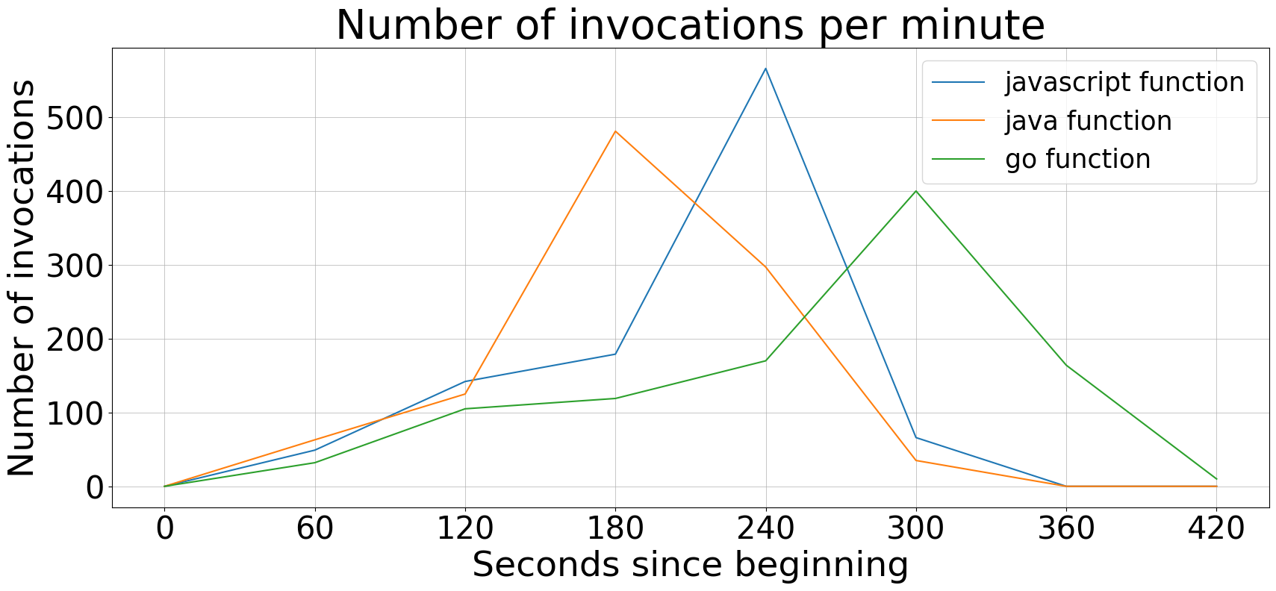
Results
AWS Lambda
Azure Functions
Differences between the functions are due to the different moments in which the stresser was executed. In general there is an initial constant number of req/s followed by a peak

Slide 17
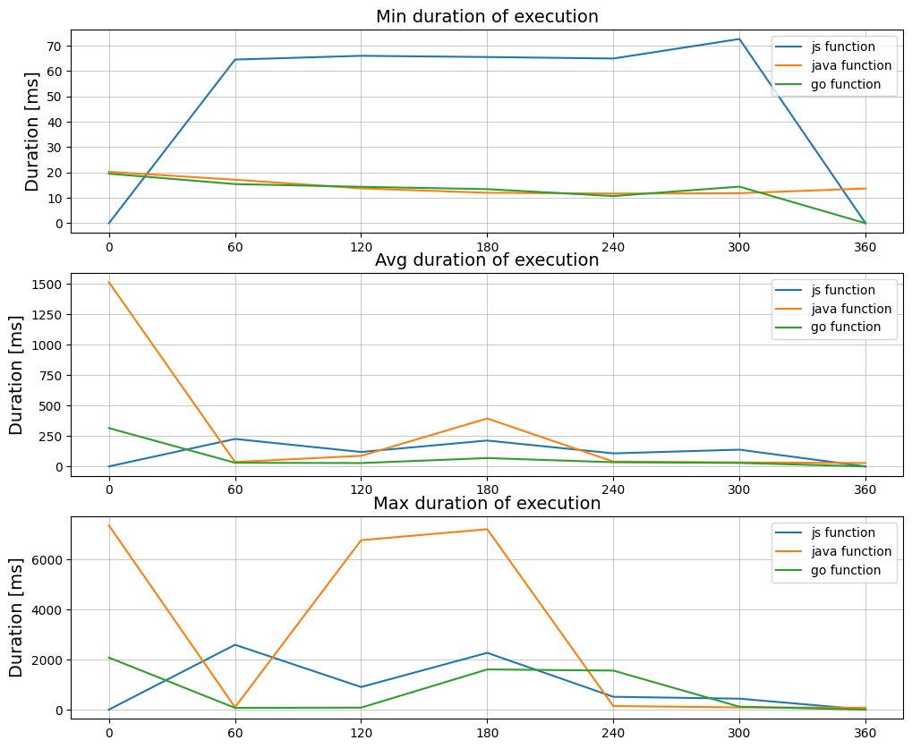
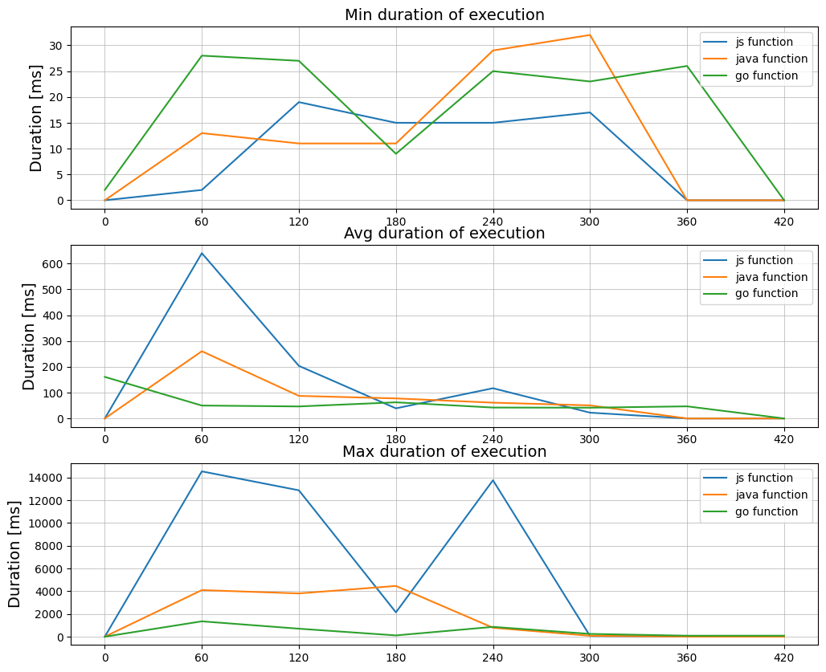
AWS Lambda
Azure Functions
Except from js function max duration, our architecture performed better on Azure

Slide 18
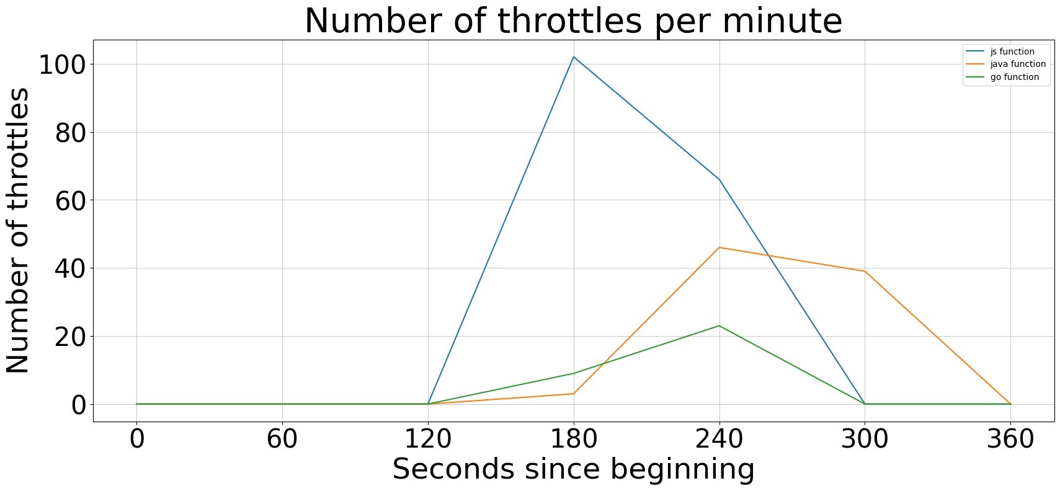
AWS Lambda
Throttles are due to the limit of ten instances running at the same time per function. This is why we don’t have throttles in Azure.

Slide 19
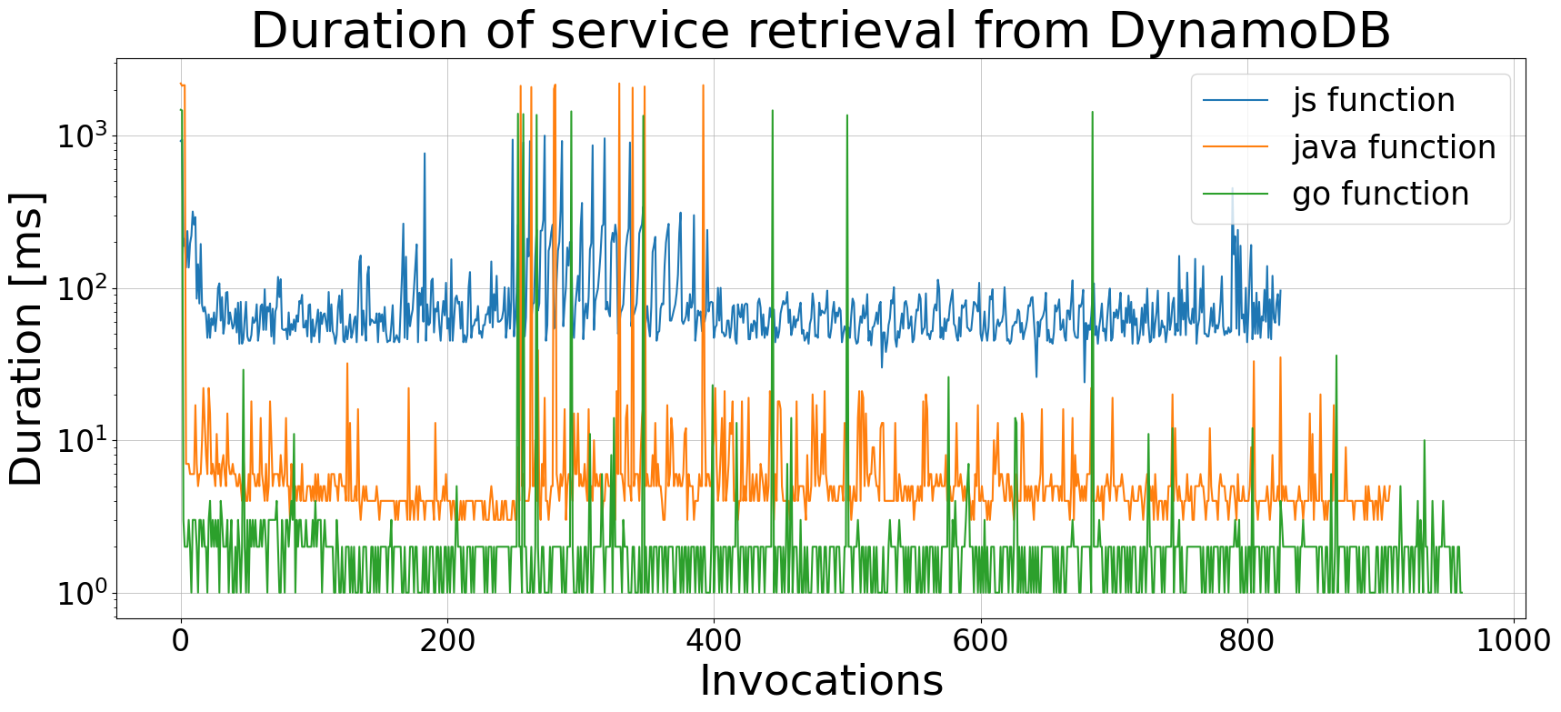
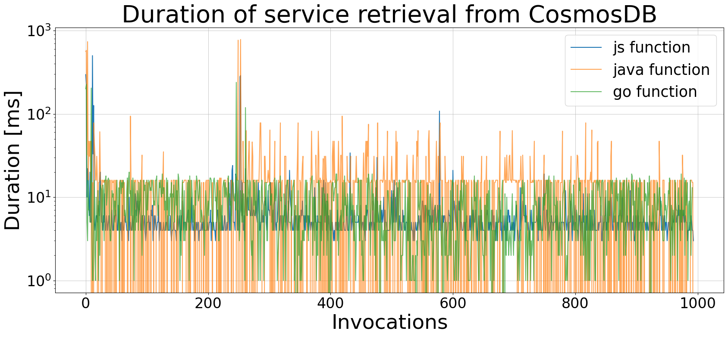
AWS Lambda
Azure Functions
Peaks correspond to the creation of new connections to the DBs. In the graphic on the right we can notice that there are less peaks. This means that Azure could serve all the incoming requests with a smaller number of instances per function.

Slide 20
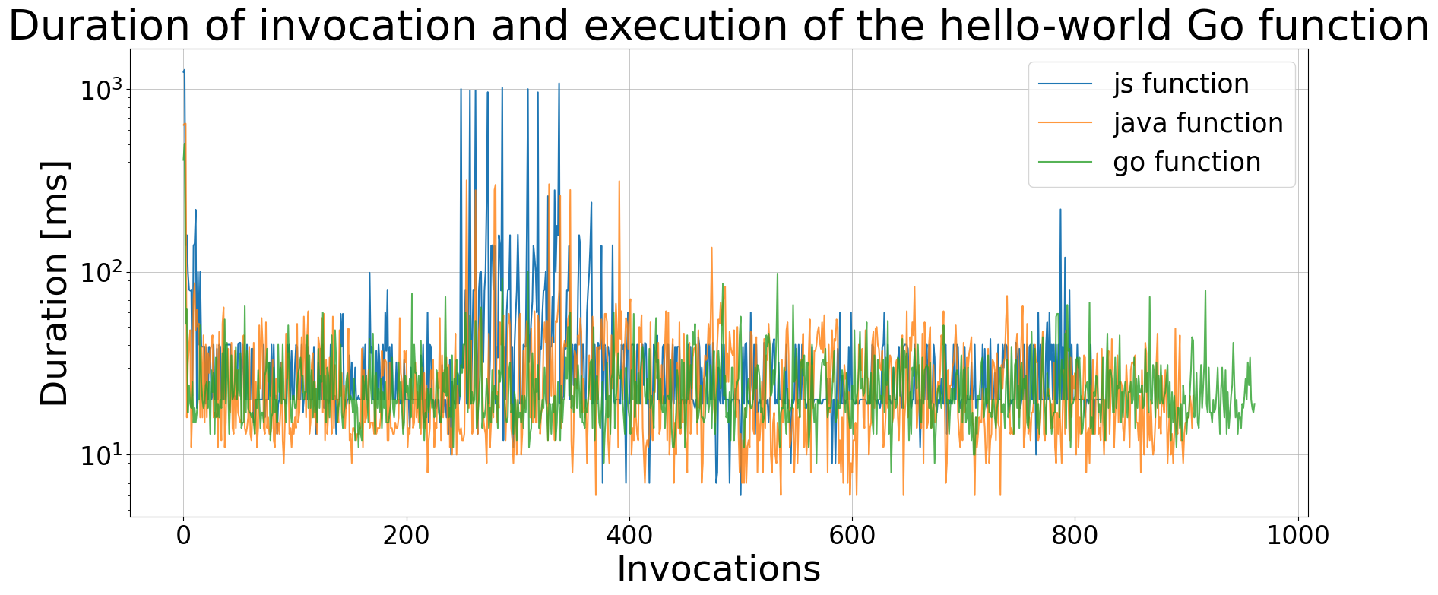
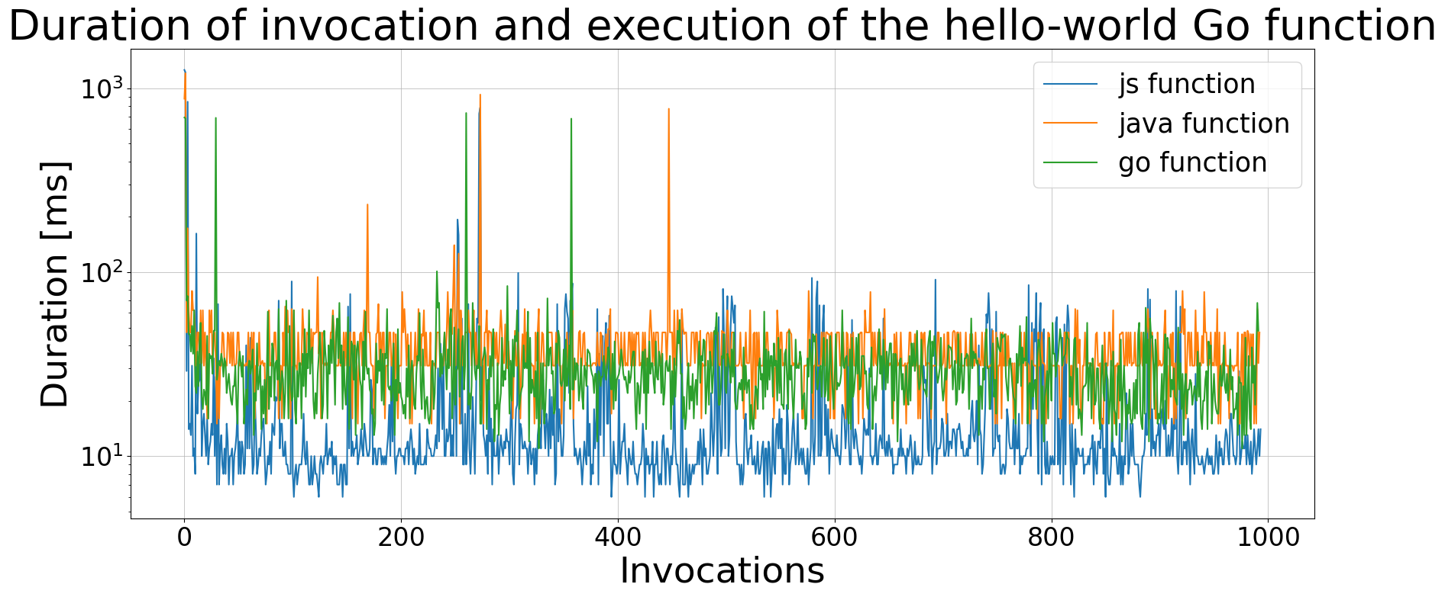
AWS Lambda
Azure Functions
The javascript function performed a lot better on Azure, while the java function performed slightly worse. Nevertheless, on Azure we had less peaks (= less hello-world function instances)

Slide 21
Conclusions
Our architecture performs better on Azure Functions, both in terms of average latency and resource usage
CosmosDB’s SDKs performed better both in creating new connections and reading the data, except from Go SDK
Service binding duration is similar on both the platforms, except from the javascript function on Azure that performed better

Slide 22
Further research
Vendor lock-in
No control on the infrastructure
Private ecosystems
On-premises solutions

